Slide 1
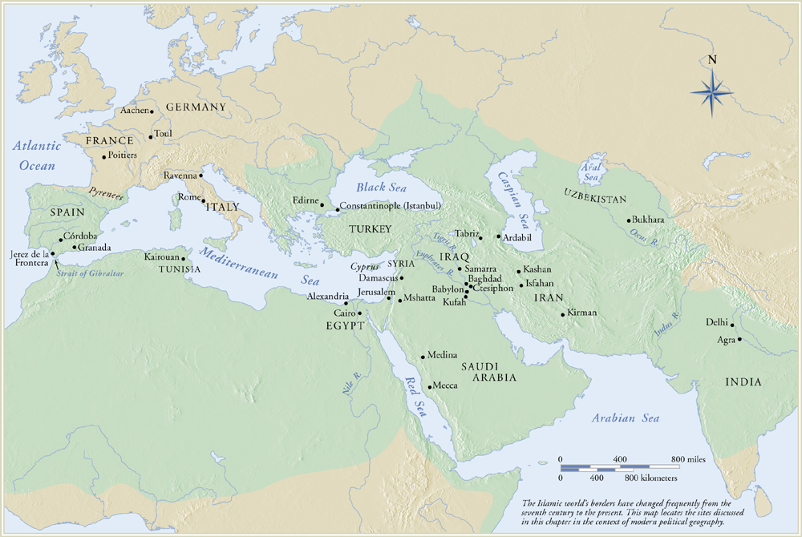
The Islamic World: 622-1575 CE

Slide 2
Islam: Origins and Tenets
Islam means to submit to God. The religion arose in Saudi Arabia in the early 7th c. CE. Before the advent of Islam, the people of this region were polytheistic.
Muhammad (570-632 CE) recognized as the final prophet of God
Religion of the Book: Koran (means Recitations).
5 Pillars of Faith:
Profess faith in one God.
Pray 5 times/day facing Mecca.
Give alms to the poor.
Abstain from food and smoking during Ramadan (month-long celebration of revelations to Muhammad).
Make pilgrimage (hajj) to Mecca

Slide 3
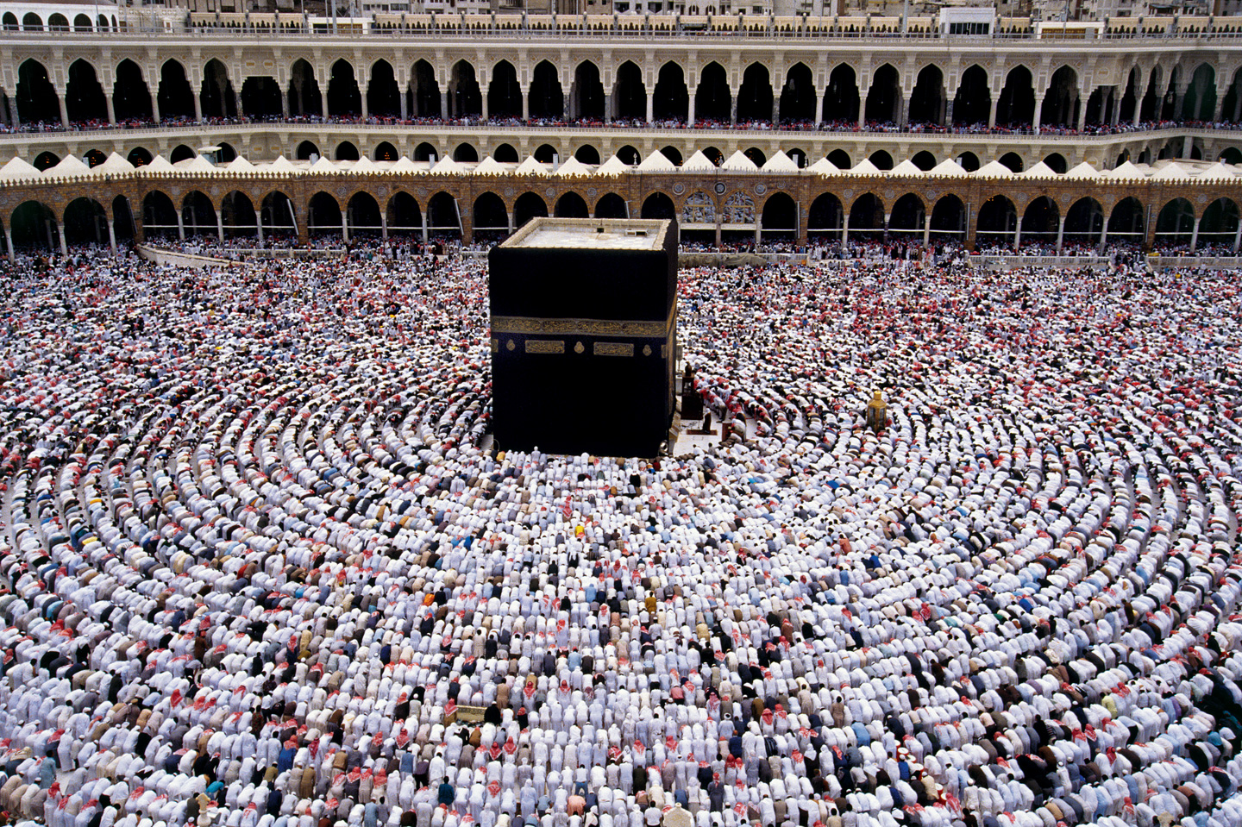
Ka’aba, Mecca, Saudi Arabia, pre-Islamic in date

Slide 4
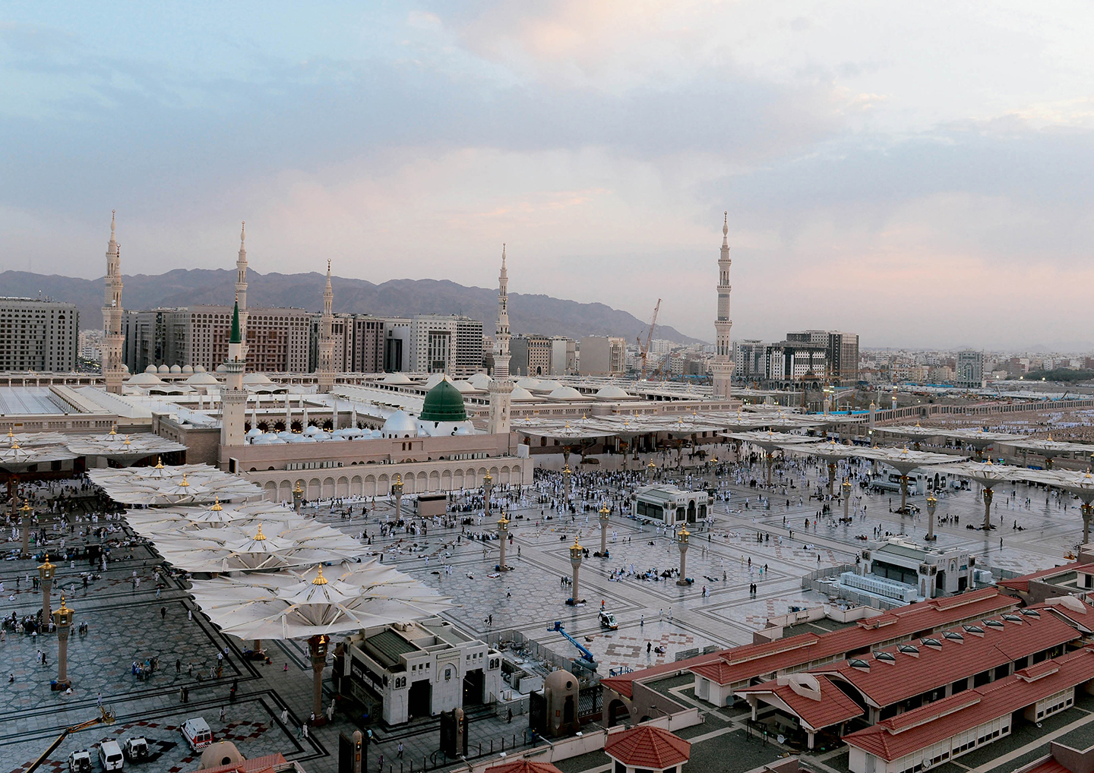
Masjid al-Nabawi (The Prophet’s Mosque), Medina, Saudi Arabia
Islam dates its beginnings from the Hijra (emigration) occurred in 622 CE = Year 1 in the Muslim calendar.

Slide 5
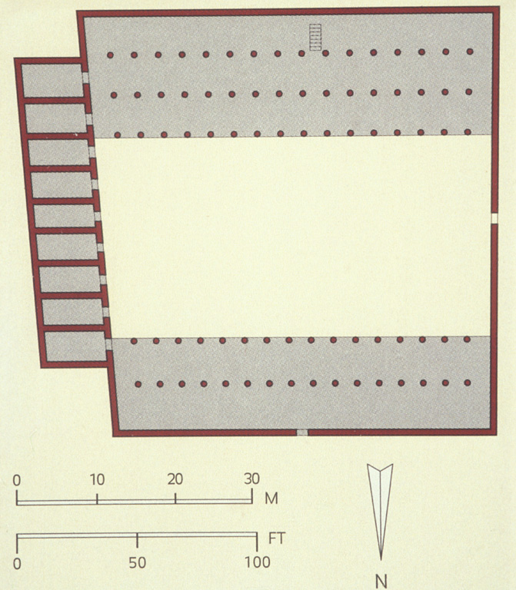
Plan of the house of the Prophet, Muhammad, Medina, c. 632

Slide 6
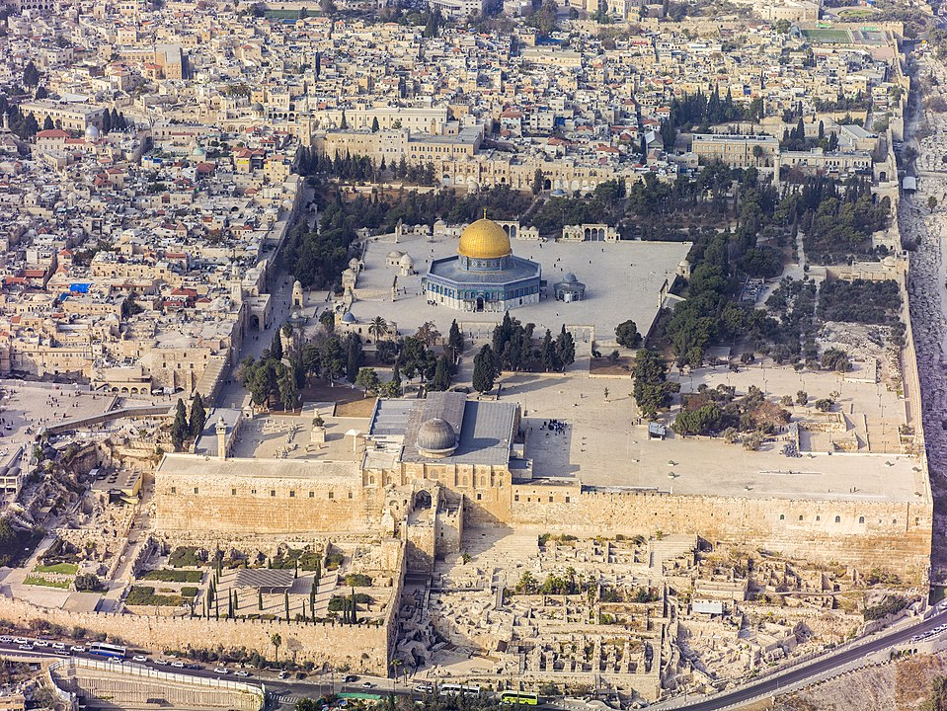
Haram al-Sharif, Jerusalem. Site of Dome of the Rock and Al-Aqsa Mosque. Former site of Jewish Temple.

Slide 7
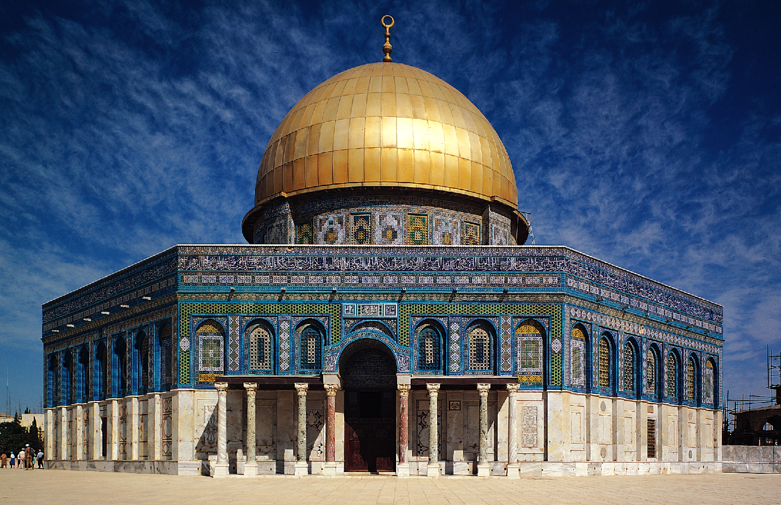
Abd al-Malik, Dome of the Rock, Jerusalem, 687–692.

Slide 8
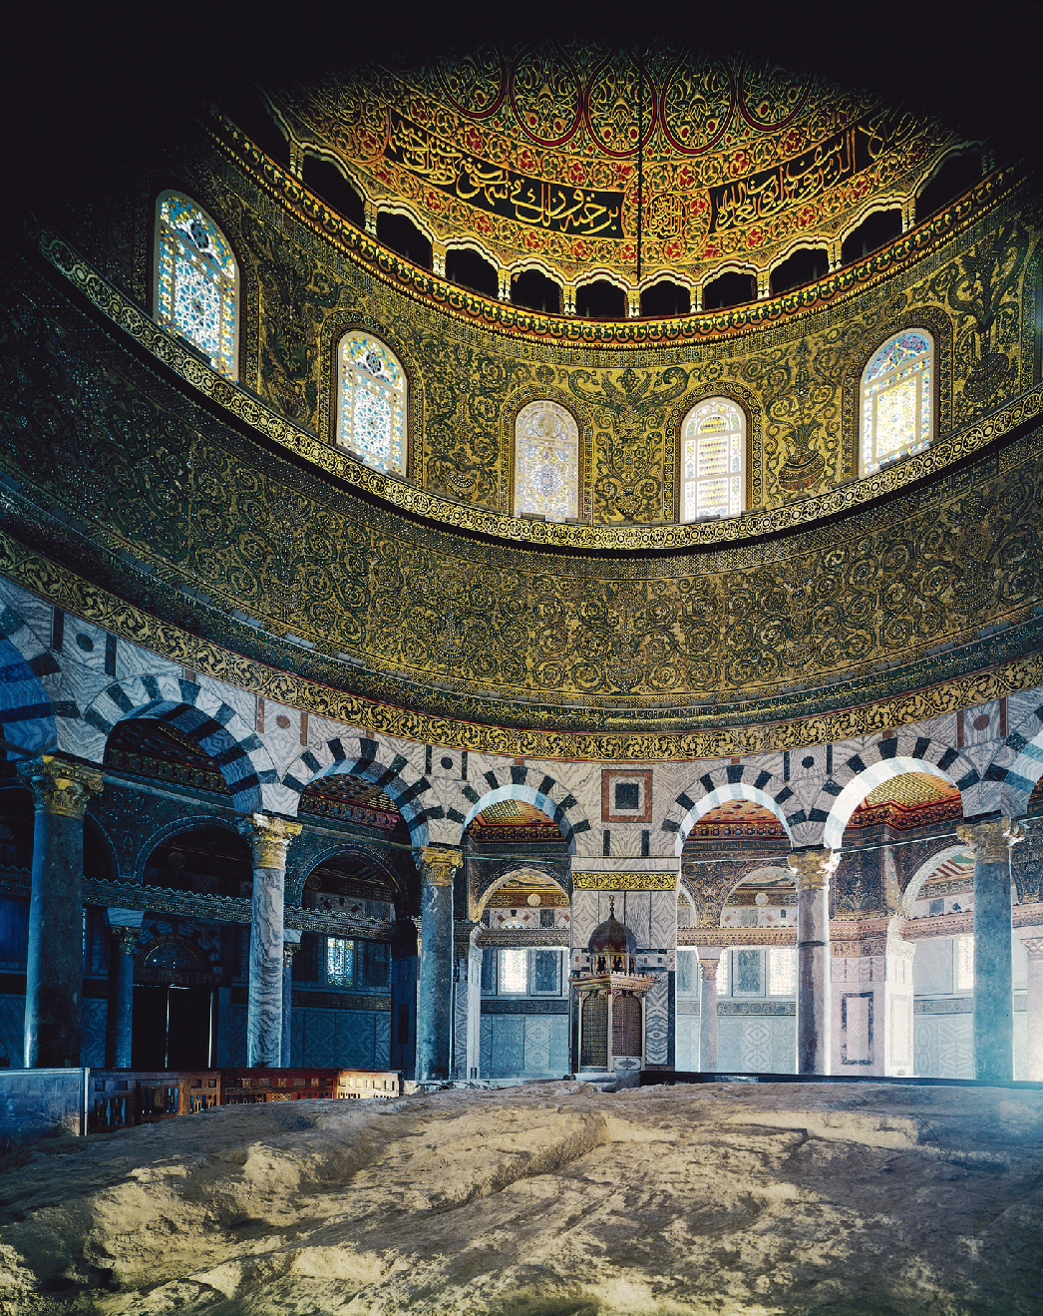
Interior of the Dome of the Rock, Jerusalem, 687–692.

Slide 9
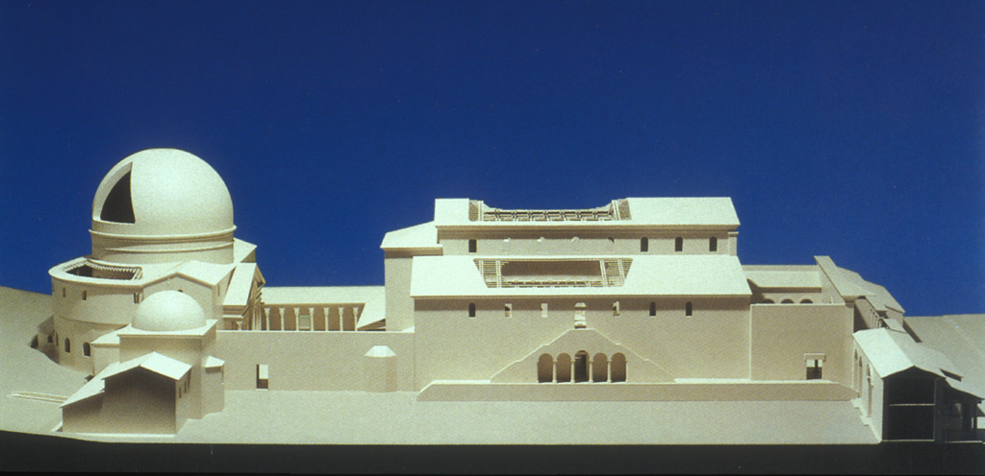
Model of the Church of the Holy Sepulchre, Jerusalem, at the time of its construction by Constantine, c. 325.

Slide 10
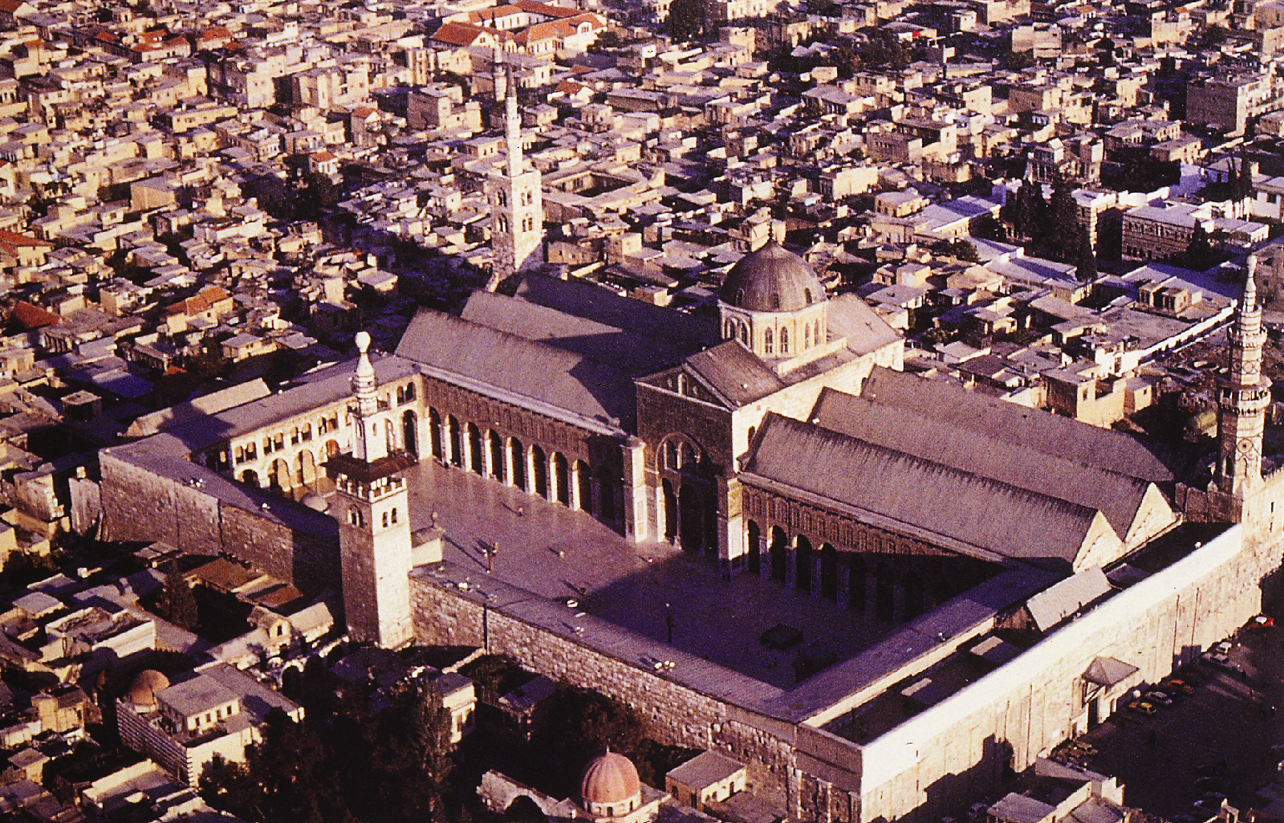
Aerial view of the Great Mosque, Damascus, Syria, 706–715.

Slide 11
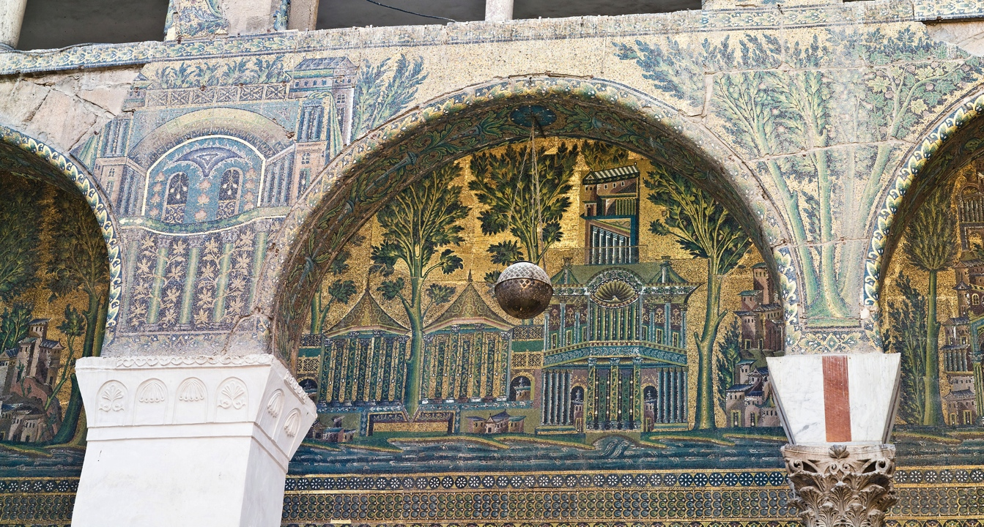
Detail of a mosaic in the courtyard arcade of the Great Mosque, Damascus, Syria, 706–715.

Slide 12
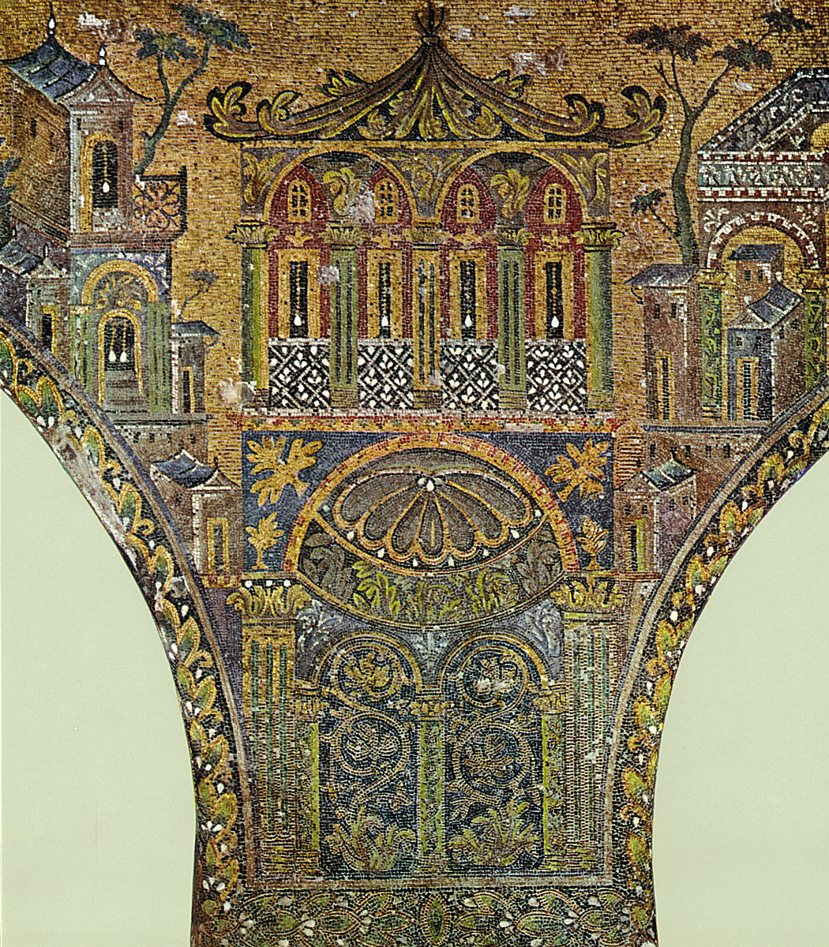
Detail of a mosaic in the courtyard arcade of the Great Mosque, Damascus, Syria, 706–715.

Slide 13
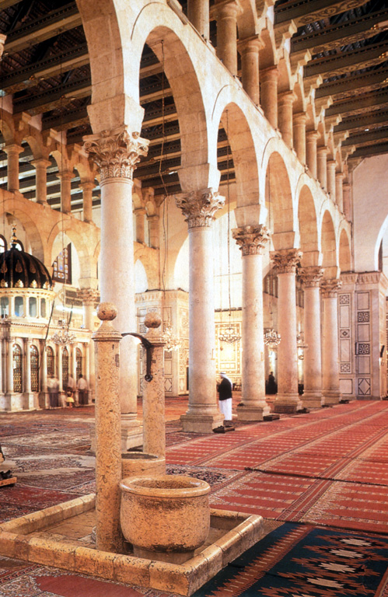
Hypostyle hall, Great Mosque, Damascus, c. 706. Patron: al-Walid

Slide 14
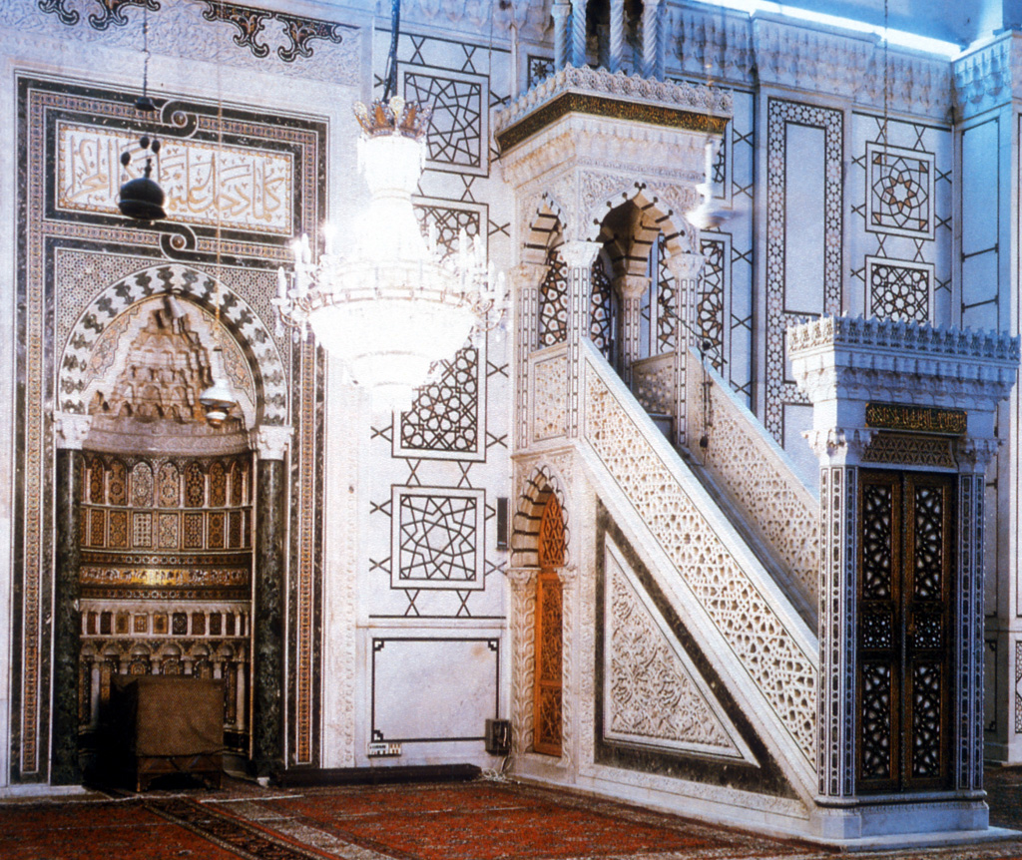
Mihrab and Minbar, hypostyle hall, Great Mosque, Damascus

Slide 15
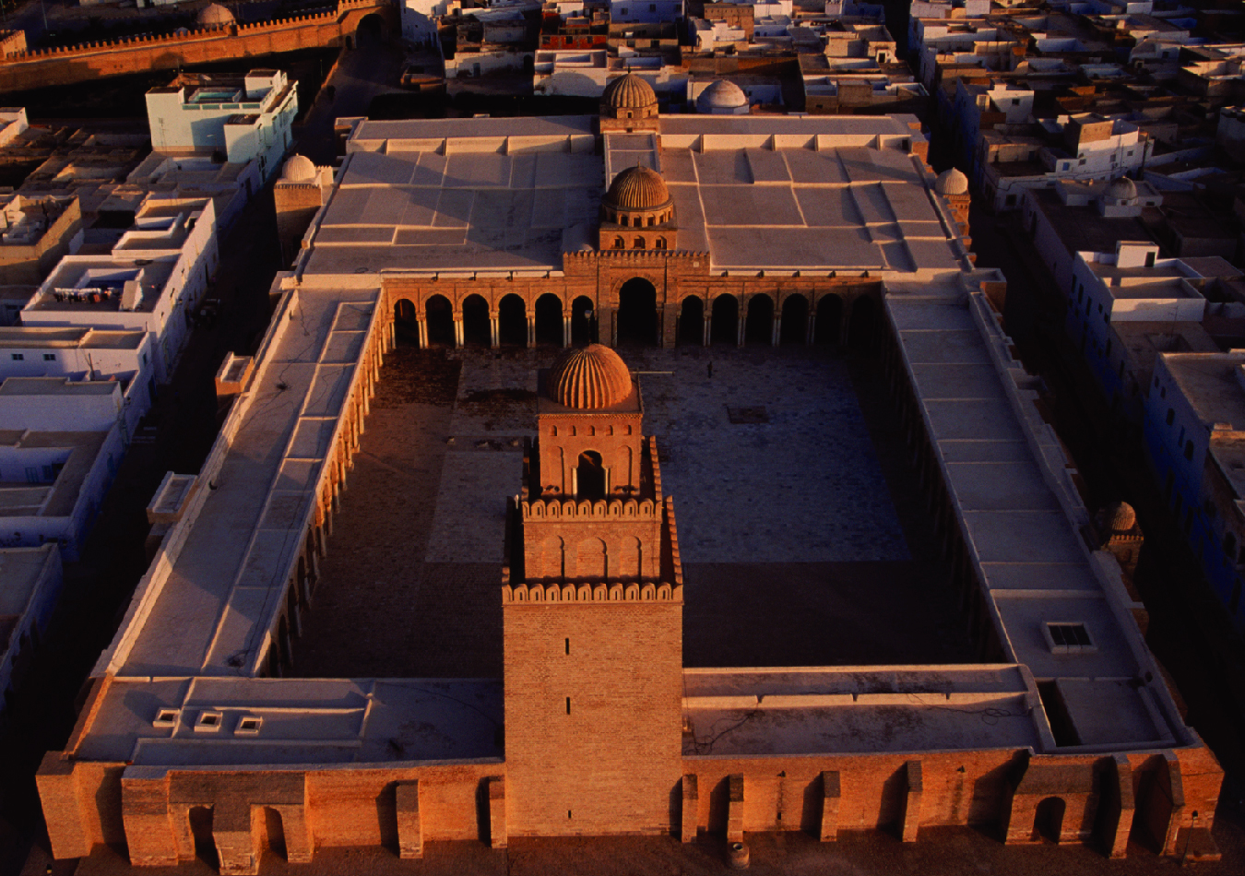
Aerial view of the Great Mosque, Kairouan, Tunisia, ca. 836–875.

Slide 16
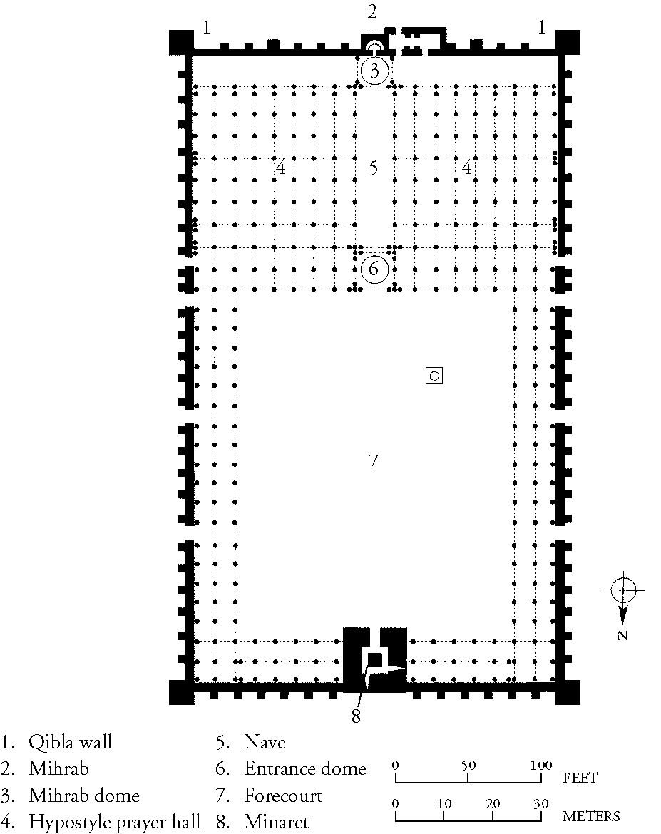
Plan of the Great Mosque, Kairouan, Tunisia, ca. 836–875.

Slide 17
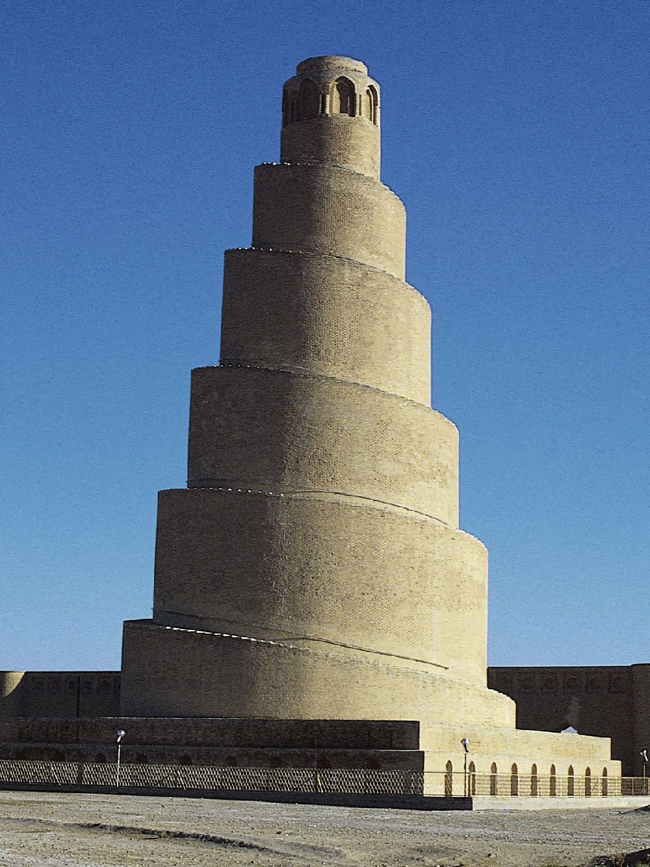
Malwiya minaret of the Great Mosque, Samarra, Iraq, 848–852.

Slide 18
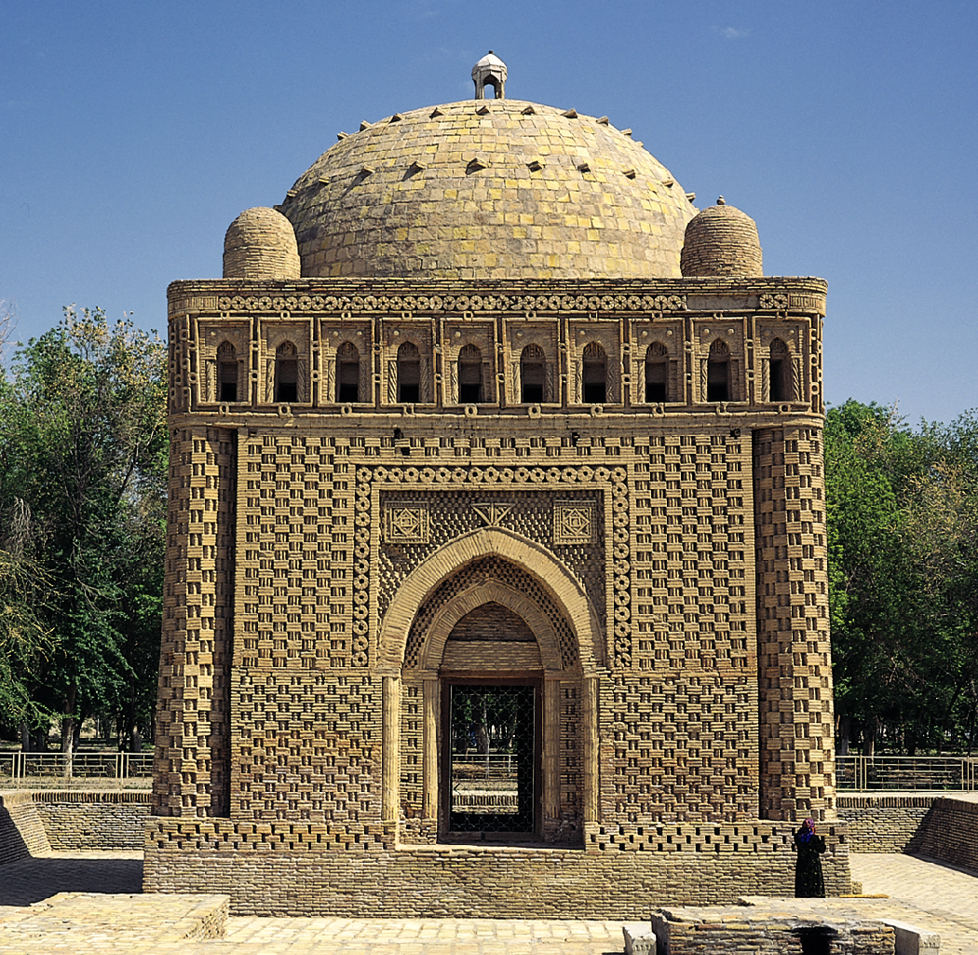
Mausoleum of the Samanids, Bukhara, Uzbekistan, early tenth century.

Slide 19
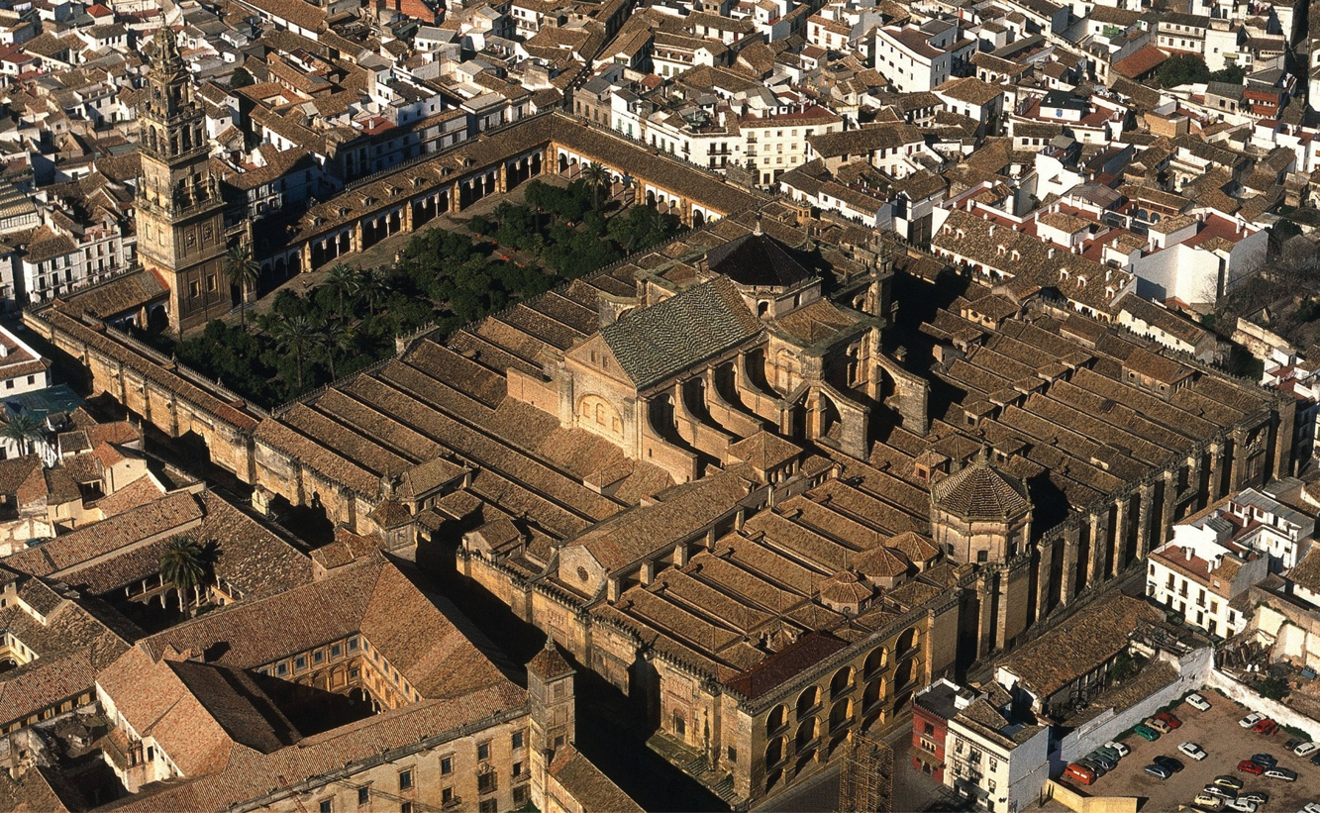
Aerial view of the Great Mosque (looking east), Córdoba, Spain, 8th to 10th centuries; rededicated as the Cathedral of Saint Mary, 1236.

Slide 20
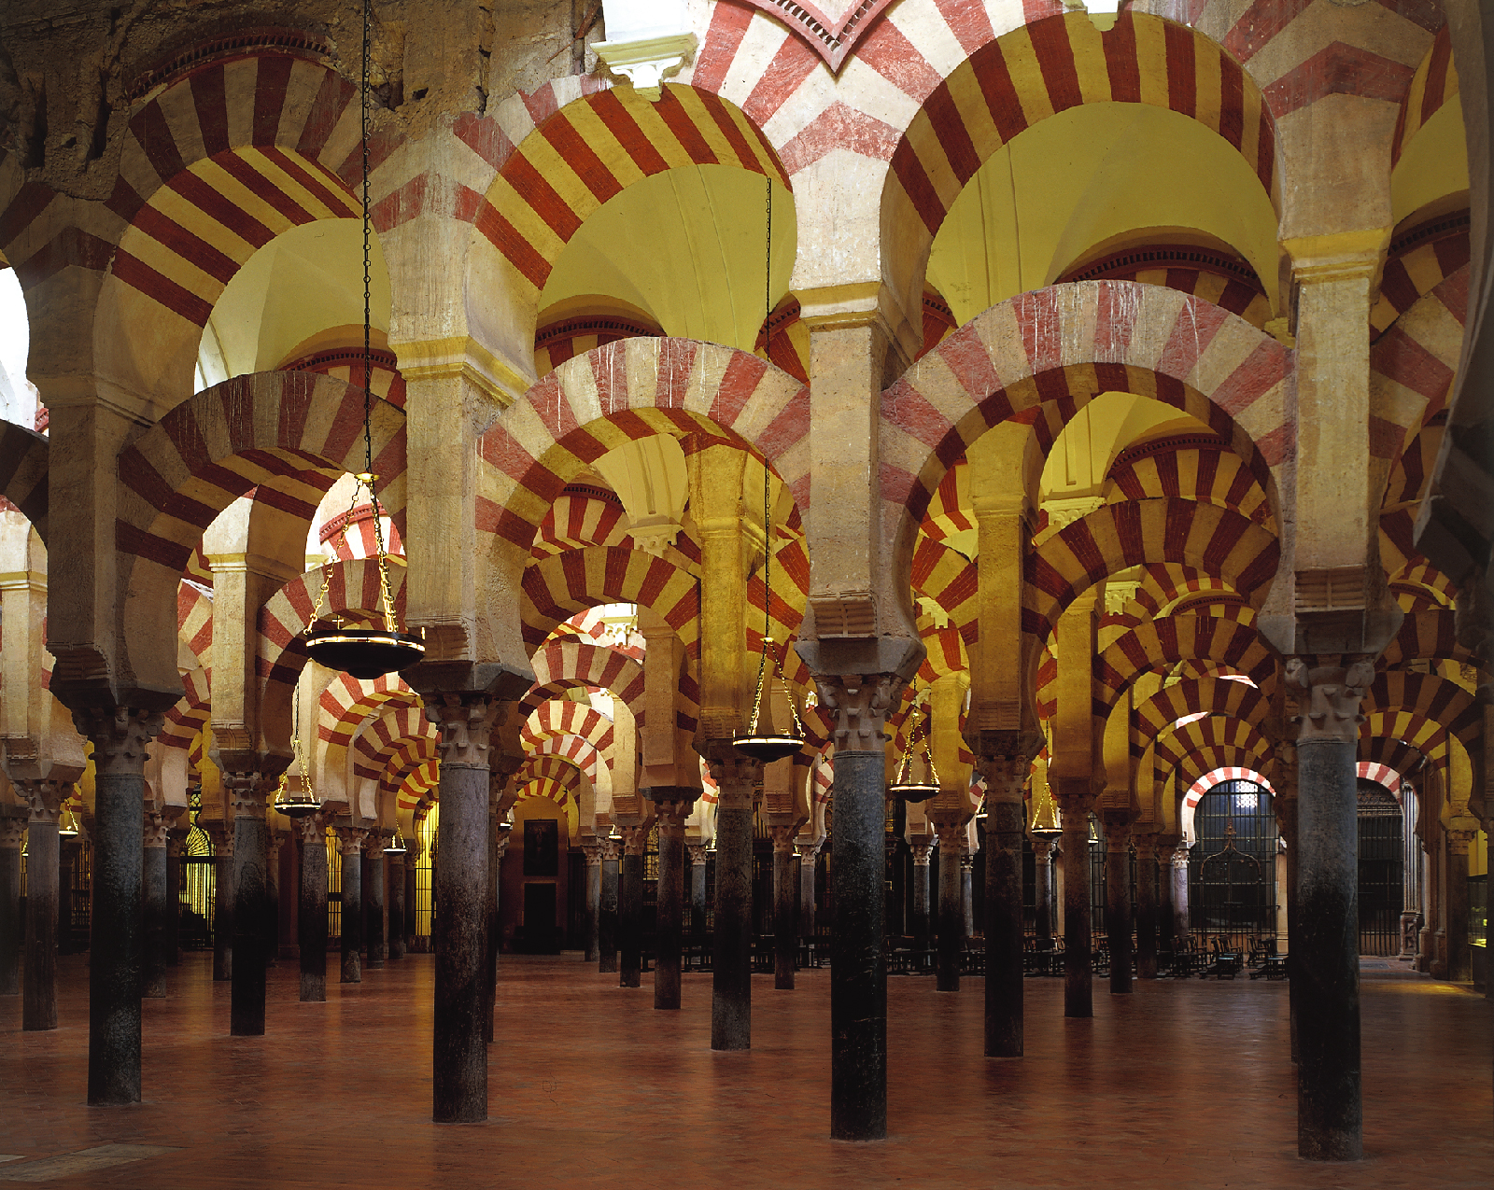
Prayer hall of the Great Mosque, Córdoba, Spain, eighth to tenth centuries.

Slide 21
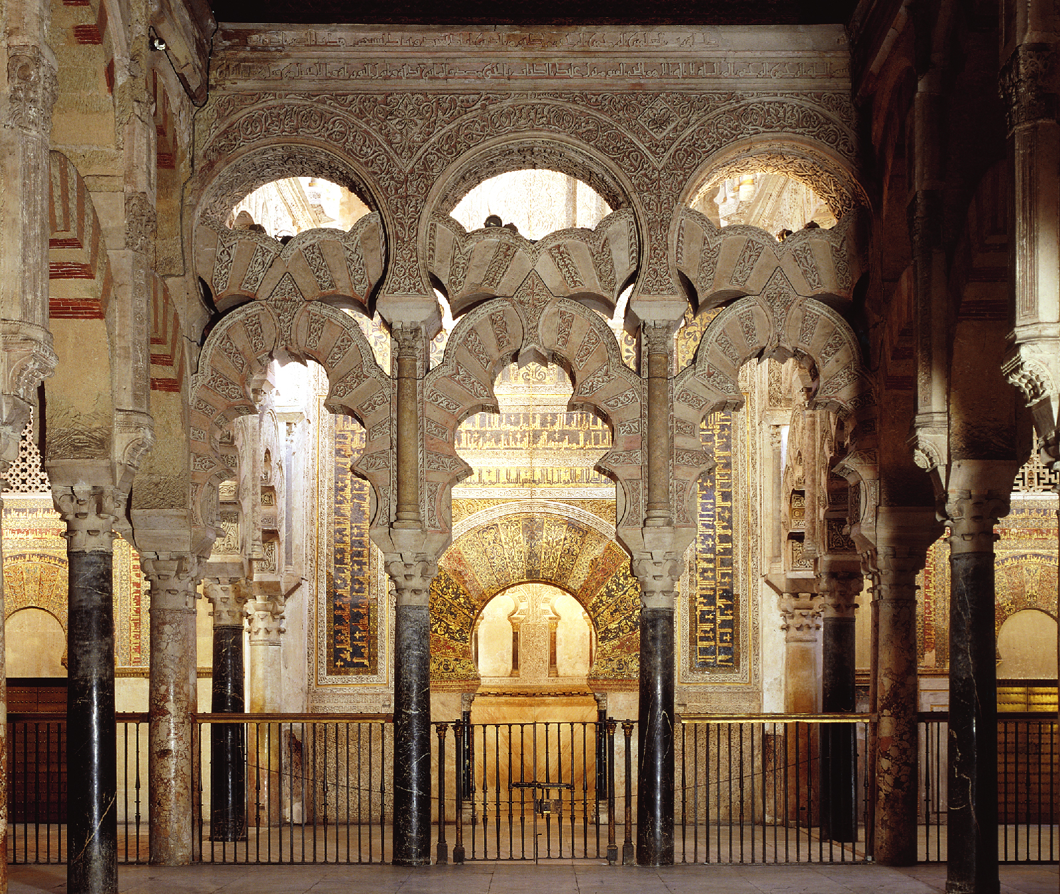
Maqsura of the Great Mosque, Córdoba, Spain, 961–965.

Slide 22
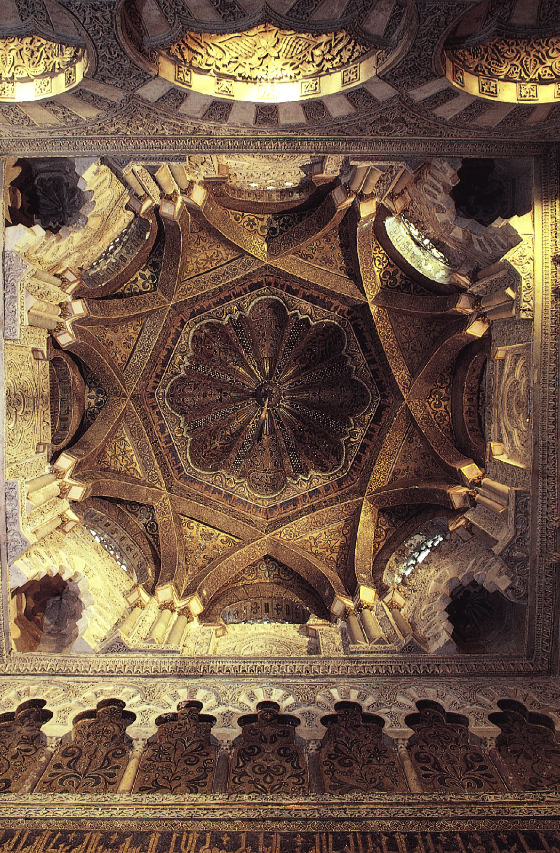
Dome in front of the mihrab of the Great Mosque, Córdoba, Spain, 961–965.

Slide 23
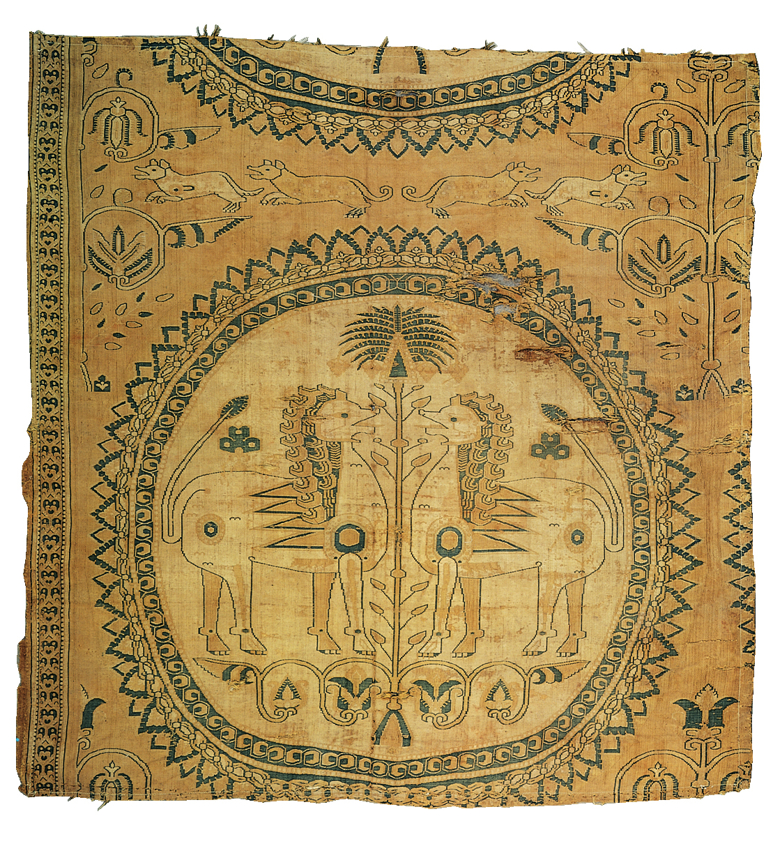
Confronting lions and palm tree, fragment of a textile said to be from Zandana, near Bukhara, Uzbekistan, eighth century. Silk compound twill, 2’ 11” x 2’ 9 1/2”. Musée Historique de Lorraine, Nancy.

Slide 24
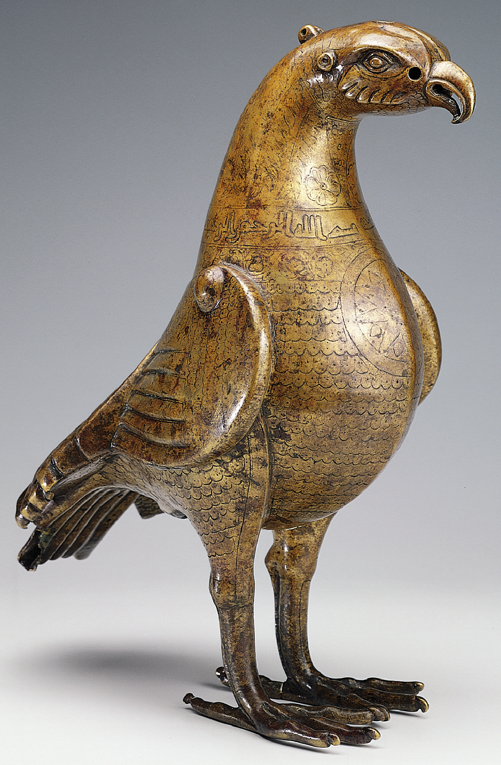
SULAYMAN, Ewer in the form of a bird, 796. Brass with silver and copper inlay, 1’ 3” high. Hermitage, Saint Petersburg.

Slide 25
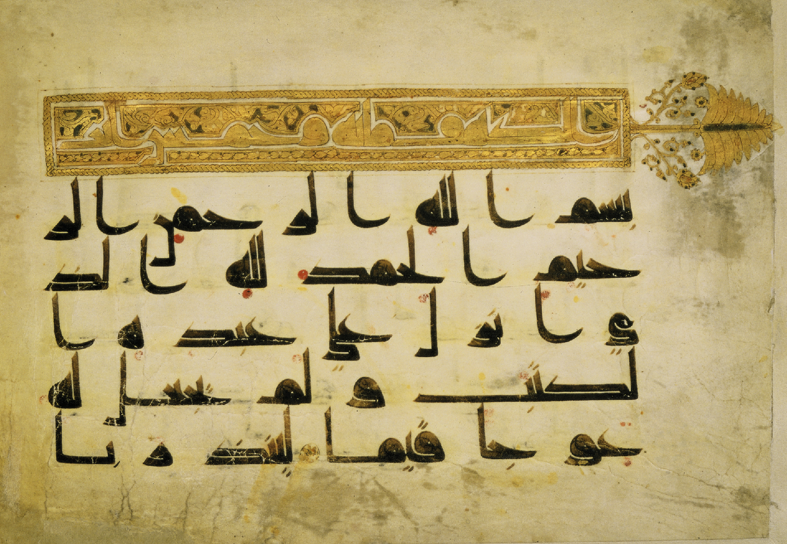
Koran page with beginning of surah 18, al-Kahf (The Cave), ninth or early tenth century. Ink and gold on vellum, 7 1/4” x 10 1/4”. Chester Beatty Library and Oriental Art Gallery, Dublin.

Slide 26
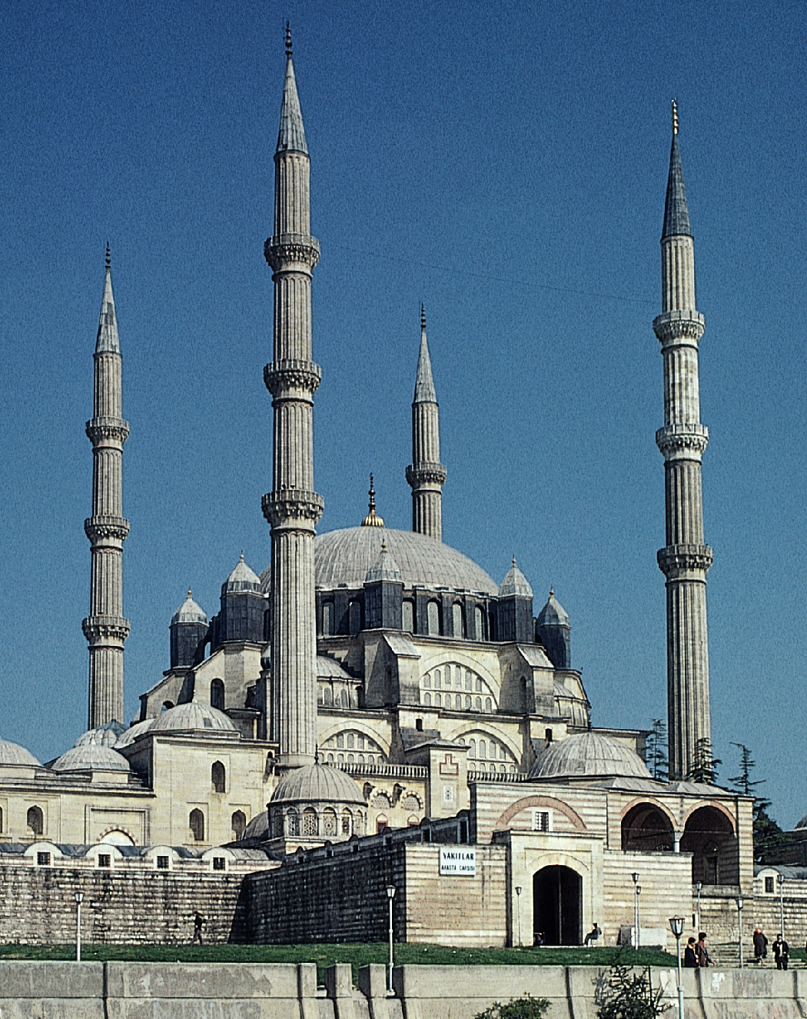
SINAN, Mosque of Selim II, Edirne, Turkey, 1568–1575.

Slide 27
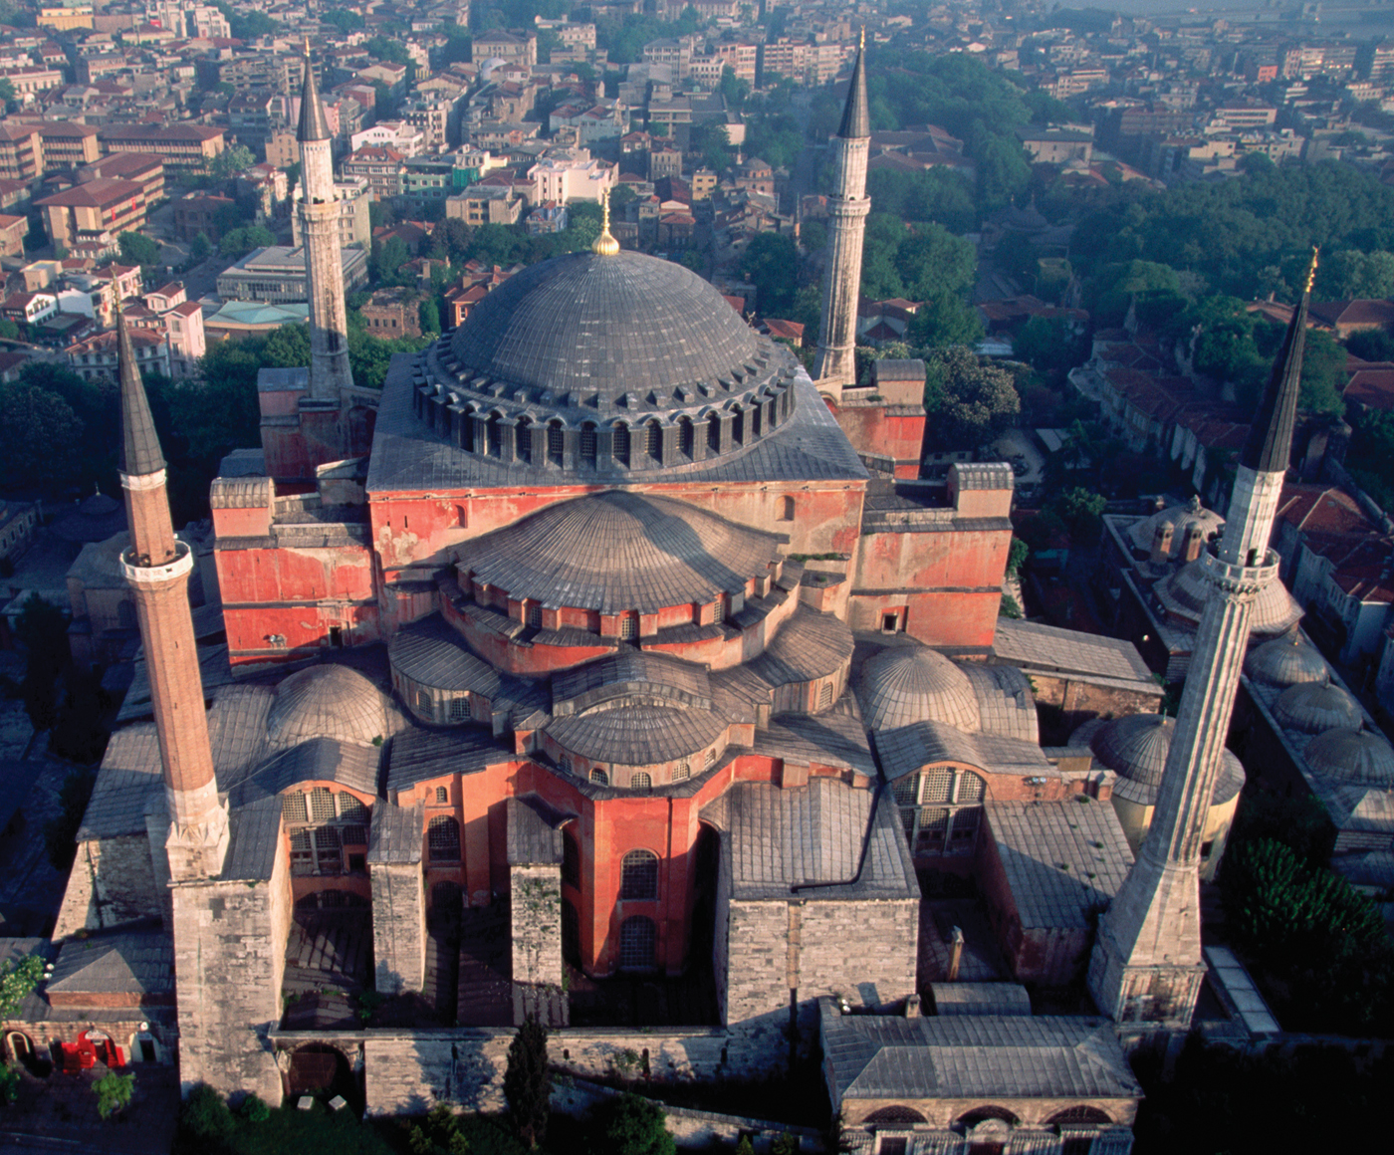
ANTHEMIUS OF TRALLES and ISIDORUS OF MILETUS, Hagia Sophia (view facing north), Constantinople (Istanbul), Turkey, 532–537.

Slide 28
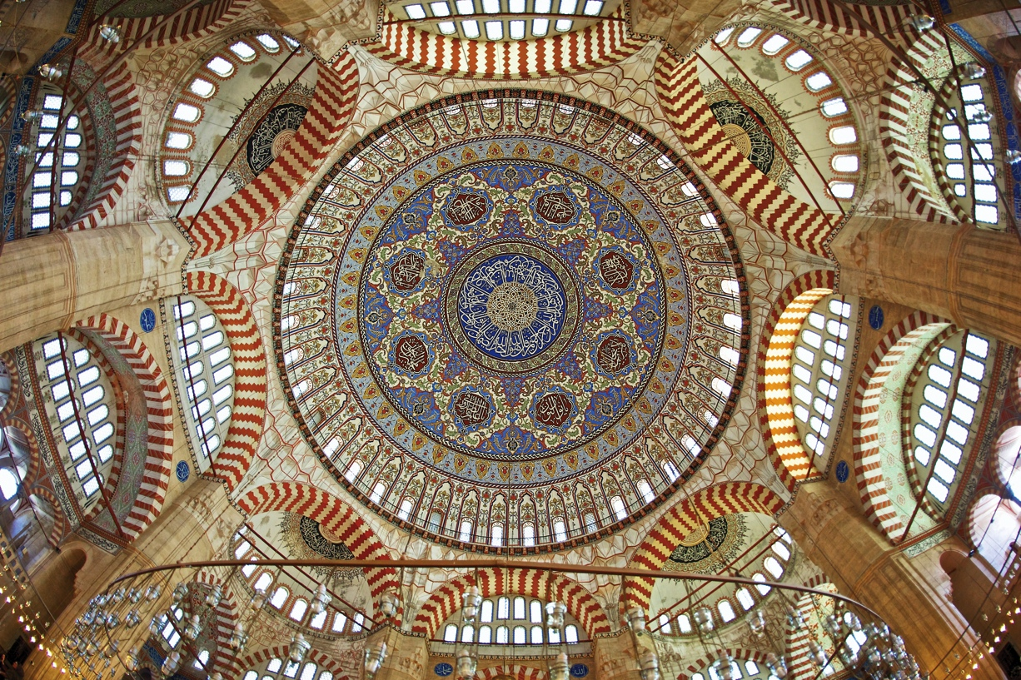
SINAN, interior of the Mosque of Selim II, Edirne, Turkey, 1568–1575.

Slide 29
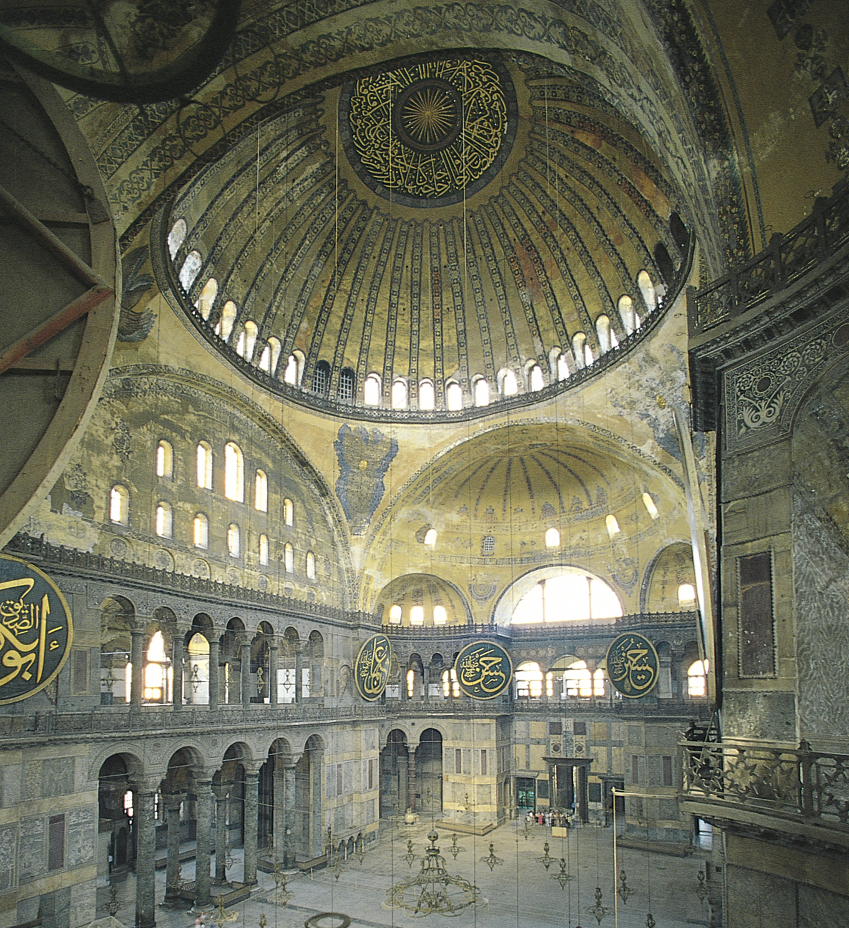
ANTHEMIUS OF TRALLES and ISIDORUS OF MILETUS, interior of Hagia Sophia (view facing southwest), Constantinople (Istanbul), Turkey, 532–537.

Slide 30
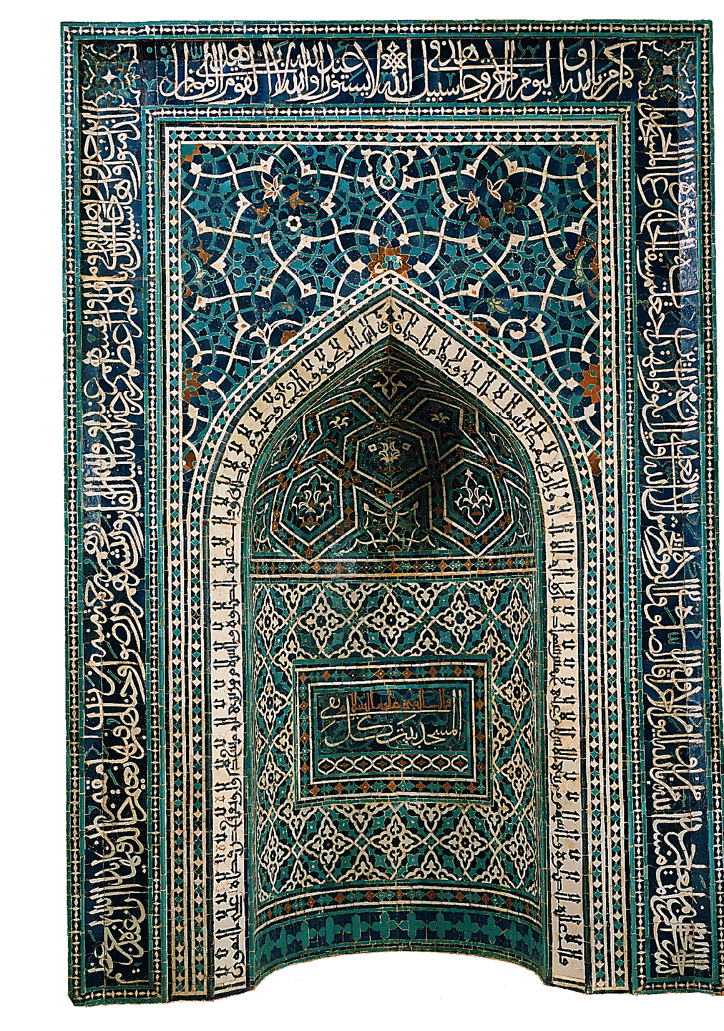
Mihrab from the Madrasa Imami, Isfahan, Iran, ca. 1354. Glazed mosaic tilework, 11’ 3” X 7’ 6”. Metropolitan Museum of Art, New York.

